Slide 1
Case Study 1
Hackathon :
Brazil Housing
- Rohan Deshmukh

Slide 2
TASK EDA Analysis
Castro Brazila Inc., a top real estate management firm with a nationwide presence in Brazil, wishes to help people choose an alternate city to relocate to.
Help the firm figure out suitable cities for relocation for
Bachelors
Mid-sized families
Large families

Slide 3
Flow of program
Saving Data provided in to data frame for analysis
Checking for null values if any replacing it delete those values
Differentiating which columns are numerical and categorical
Getting mean, standard deviation and median for numerical columns and for categorical columns we are finding mode and unique values
By studying data get the columns which we think are important for analysis
Then give condition as per the requirement and do analysis
Give optimal output for all analysis

Slide 4
Doing our Level 0 analysis for cleaning ,replacing and understanding data and finding relationship between them and separating Numerical and categorical columns in different list

Slide 5
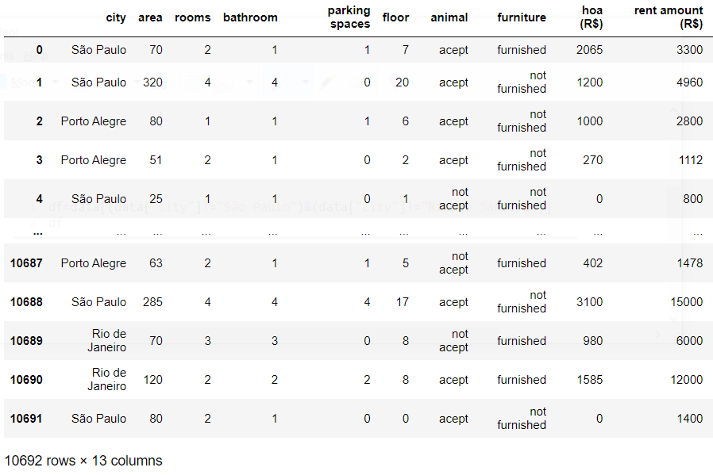
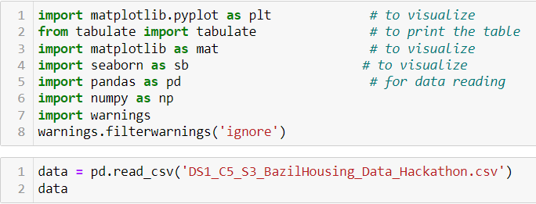
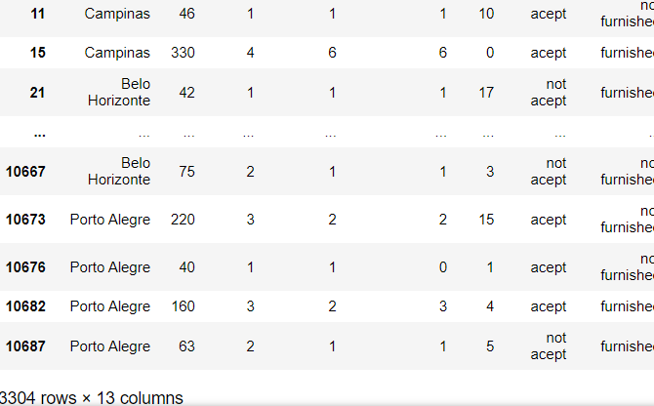
Step 1:
Importing libraries , storing data into dataframe and removing or replacing some values which we don’t need
Input code
output

Slide 6
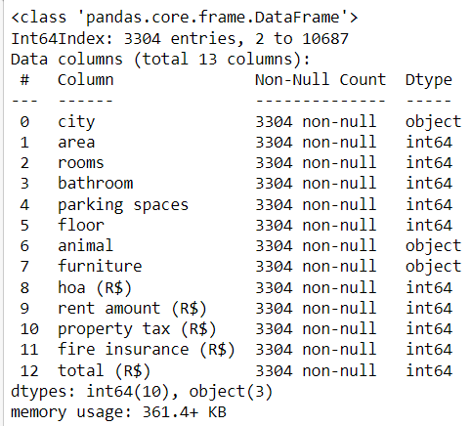

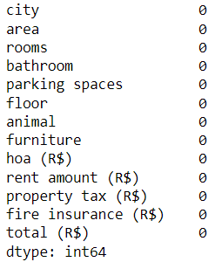

Step 2:
Checking information of data and number of null values in the data
Input code
output

Slide 7
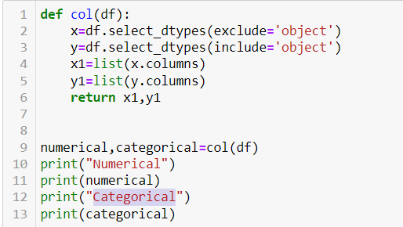
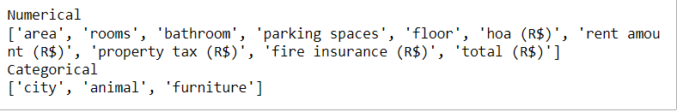
Step 3:
Differentiating columns type Numerical and Categorical
Input code
output

Slide 8
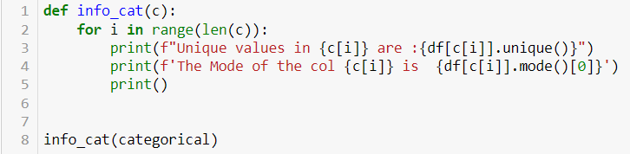
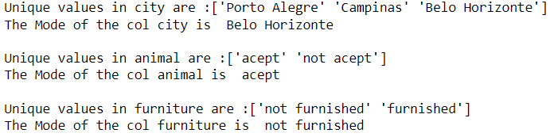
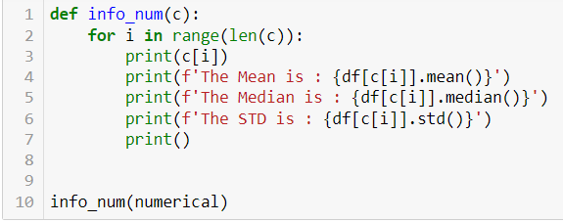
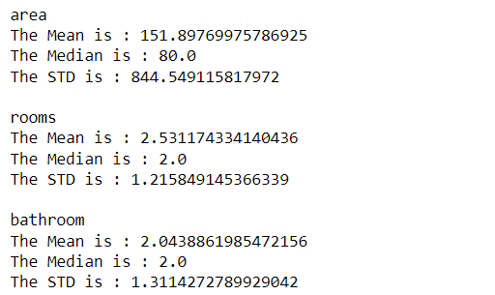
Step 4:
Getting mean, standard deviation and median for numerical and for categorical finding mode and unique values
Input code
output

Slide 9
According to my understanding and thought process I concluded with these columns :
Pets
Furniture
Parking space
And doing the analysis base on the above column for each requirement provided for
analysis
By using Bi-Variant analysis we are able to get the optimal solution

Slide 10
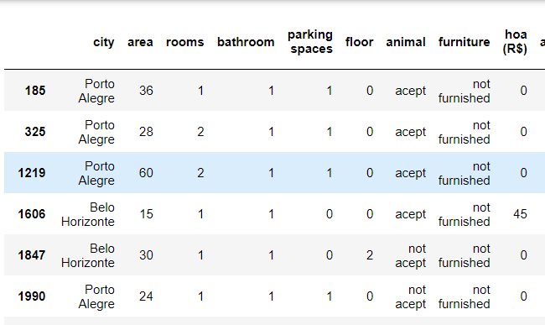

Step 5: housing for bachelor
Giving condition for bachelor as total cost<=800 and no. of room 1 or 2
Input code
output

Slide 11
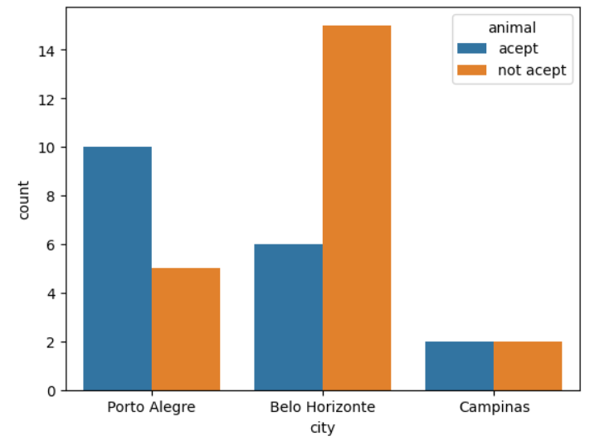

Step 5.1: Analysis based on pets
If person has pets or not than:
Input code
output
Conclusion : if person don’t have pet then he/she need to choose Belo Horizonte
if person have pet then he/she need to choose Porto Alegre

Slide 12
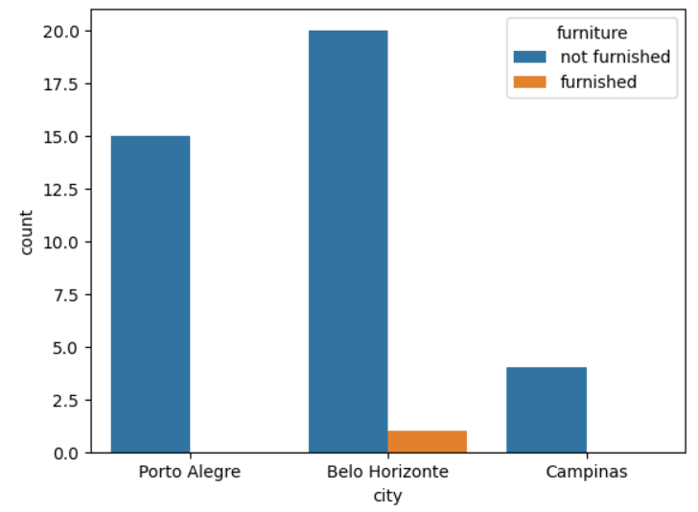

Step 5.2:Analysis based on Furniture
If person want furnished or not furnished house than:
Input code
output
Conclusion : if person want not furnished then he/she need to choose Belo Horizonte
if person want furnished then he/she need to choose Belo Horizonte

Slide 13
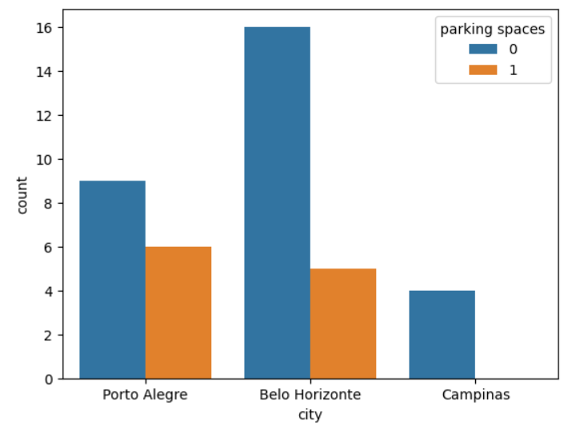

Step 5.3: Analysis based on Parking space
If person want Parking Space than:
Input code
output
Conclusion : if person want no Parking Space then he/she need to choose Belo Horizonte
if person want 1 Parking Space then he/she need to choose Porto Alegre

Slide 14
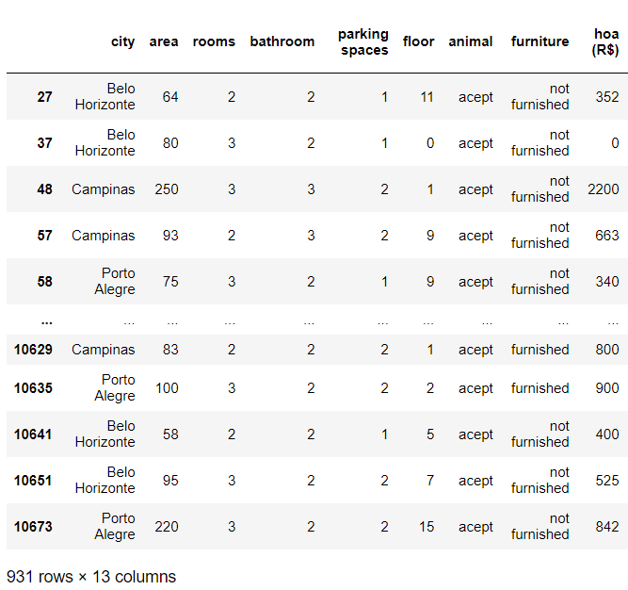

Step 6: housing for mid_size Family
Giving condition no. of room required would be 2 or 3, need to have parking spot and maximum 2 bathrooms
Input code
output

Slide 15
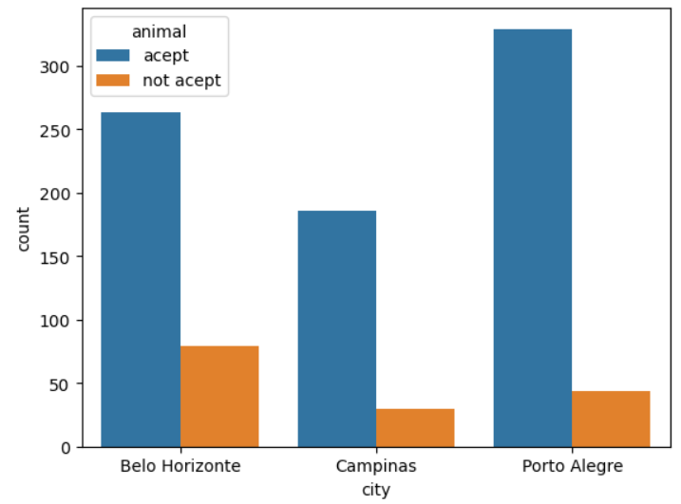
Step 6.1: Analysis based on pets
If person has pets or not than:
Input code
output
Conclusion : if person don’t have pet then he/she need to choose Porto Alegre
if person have pet then he/she need to choose Belo Horizonte

Slide 16
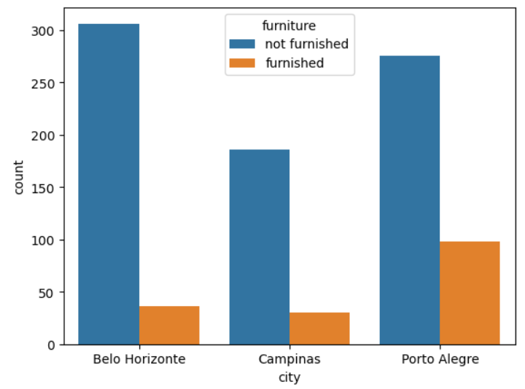
Step 6.2: Analysis based on Furniture
If person want furnished or not furnished house than:
Input code
output
Conclusion : if person want not furnished then he/she need to choose Belo Horizonte
if person want furnished then he/she need to choose Porto Alegre

Slide 17
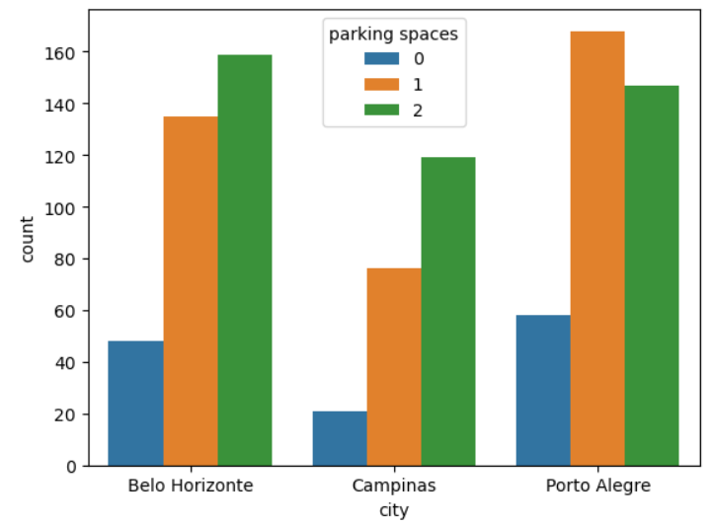
Step 6.3:Analysis based on Parking space
If person want Parking Space than:
Input code
output
Conclusion : if person want no Parking Space then he/she need to choose Porto Alegre
if person want 1 Parking Space then he/she need to choose Belo Horizonte
if person want 2 Parking Space then he/she need to choose Porto Alegre

Slide 18
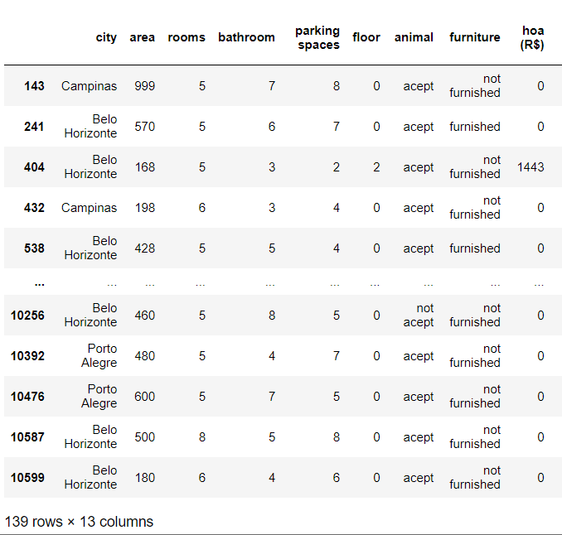

Step 7: housing for large Family
Giving condition on more than 4 rooms, more than 2 bathrooms and more than 1 parking space
Input code
output

Slide 19
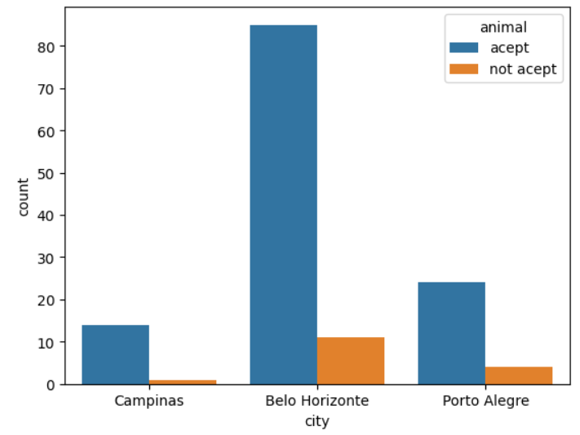
Step 7.1: Analysis based on pets
If person has pets or not than:
Input code
output
Conclusion : if person don’t have pet then he/she need to choose Belo Horizonte
if person have pet then he/she need to choose Belo Horizonte

Slide 20
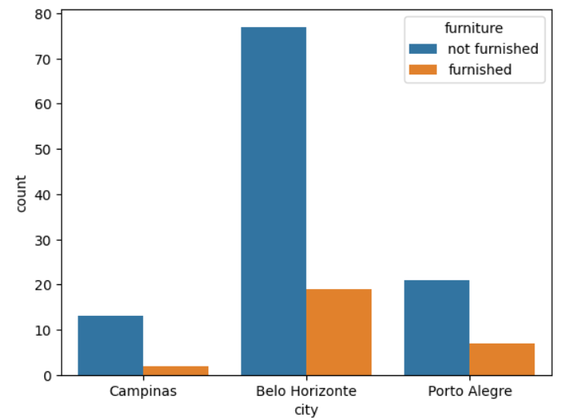
Step 7.2: Analysis based on Furniture
If person want furnished or not furnished house than:
Input code
output
Conclusion : if person want not furnished then he/she need to choose Belo Horizonte
if person want furnished then he/she need to choose Belo Horizonte

Slide 21
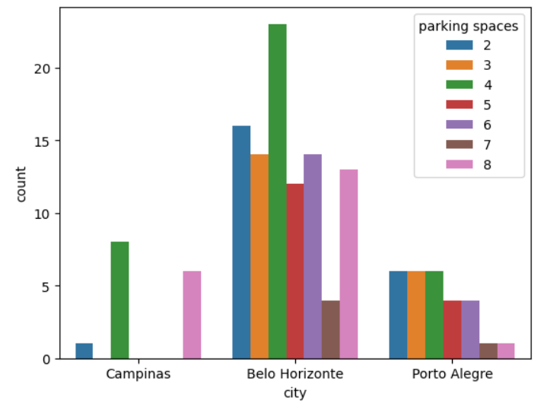
Step 7.3:Analysis based on Parking space
If person want Parking Space than:
Input code
output
Conclusion : if person want more than 1 Parking Space then he/she need to choose Belo Horizonte

Slide 22
Summary
In this Hackathon we used Condition statements and count plot graph for graphical representation of data

Slide 23
Final Conclusion
We are able to find best possible cities with specific condition such as pet, furniture and parking space for Bachelor, Mid_size family and Large family
Bachelor:
with pet: Belo Horizonte
Without pet: Porto Alegre
furnished: Belo Horizonte
Not furnished: Belo Horizonte
0 parking space: Belo Horizonte
1 parking space: Porto Alegre
Midsized Family:
with pet: Porto Alegre¶
Without pet: Belo Horizonte
furnished: Porto Alegre
Not furnished: Belo Horizonte
0 parking space: Porto Alegre
1 parking space: Porto Alegre
2 parking space: Belo Horizonte
Large Family :
with pet: Belo Horizonte
Without pet: Belo Horizonte
furnished: Belo Horizonte
Not furnished: Belo Horizonte
more then 2 parking space: Belo Horizonte

Slide 24
Thank you

